Slide 1
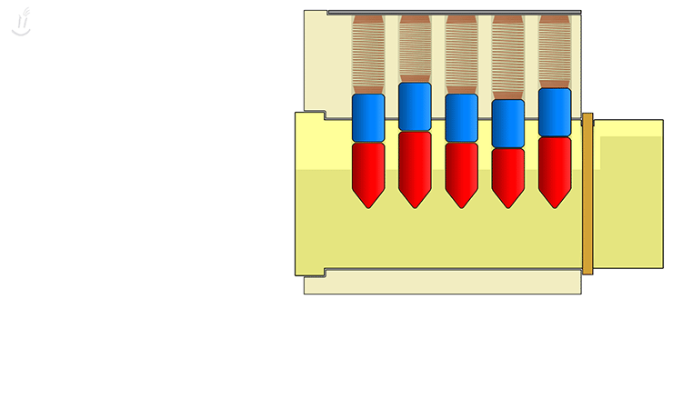

Intro to Lock Picking
TOOOL.US/store
Online we sell:
Locks! Picks! & More!
TOOOL DC ~ 1st Wednesday, every month.
630-830pm @ The Board Room
1737 Connecticut Ave. NW, Washington, DC
TOOOL BWI ~ 2nd Wednesday, every month.
7-9pm @ UnallocatedSpace.org
1029 Benfield Blvd, Millersville, MD 21108
TOOOL NoVA ~ 3rd Wednesday, every month.
7-9pm @ NoVA Labs
3850 Jermantown Rd, Fairfax, VA 22030
Ask us about: Intro Tips • High Security • Combos • Impressioning • Lock Collecting • Picks • Forensics • More?
Notes:
INSTRUCTIONS FOR THIS SLIDE
Put in talk times (1pm) or increments (
Put in details of contests or other stuff
Include: what the contest is, start/end time, time by which they must claim prize, (what the prize is, optional)
Hello! Welcome to the intro to lock picking talk!
[announcements, if any]

Slide 2
First, a word about rules…
Yes, we have rules.
☺
Do not pick locks which you do not own.
Do not pick locks upon which you rely.
https://en.wiktionary.org/wiki/own
https://en.wiktionary.org/wiki/rely
Notes:
We teach ethical lock picking.
Picking someone else’s lock is rude/illegal. We are sharing our locks with the expectation that you will pick them—you have permission to pick them.
If you rent an apartment, the locks on your unit are not yours.
Rule #2, You can damage locks by picking. Calling a locksmith to fix it is expensive and embarrassing.

Slide 3
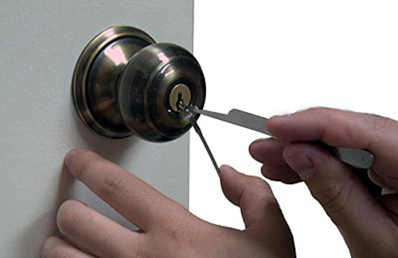
Lockpicking is Simple
Notes:
We are discussing pin tumbler lock picking. The vast majority of locks you interact with are pin tumbler locks.
Here are some examples of pin tumbler locks:
This is a pin tumbler lock.

Slide 4
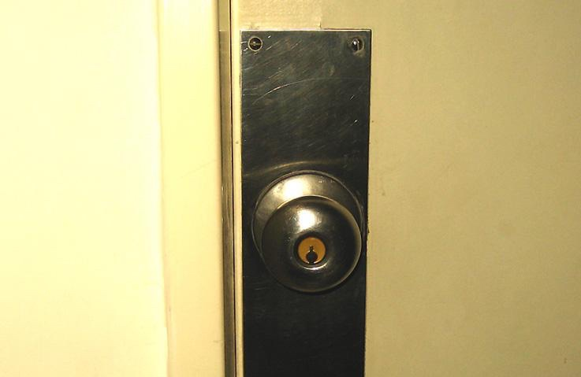
Pin Tumbler Locks
Notes:
This is a pin tumbler lock

Slide 5
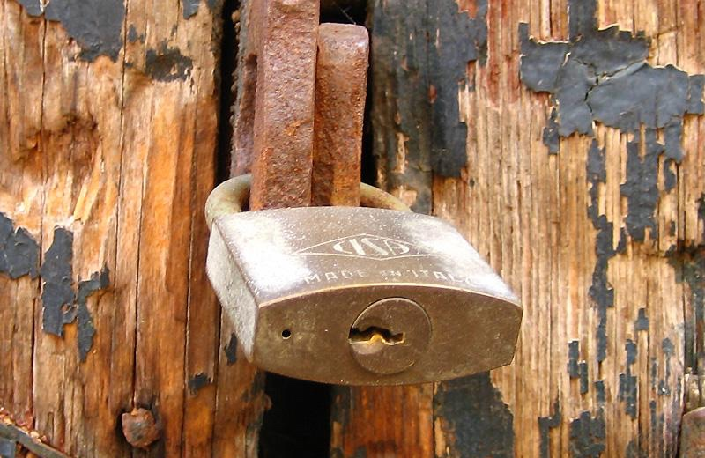
Pin Tumbler Locks
Notes:
This is a pin tumbler lock

Slide 6
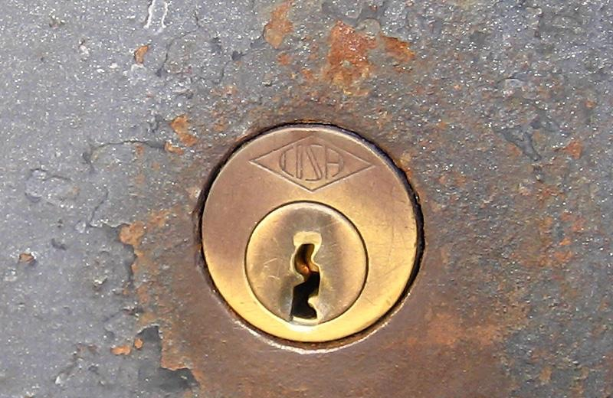
Pin Tumbler Locks
Notes:
This is a pin tumbler lock

Slide 7
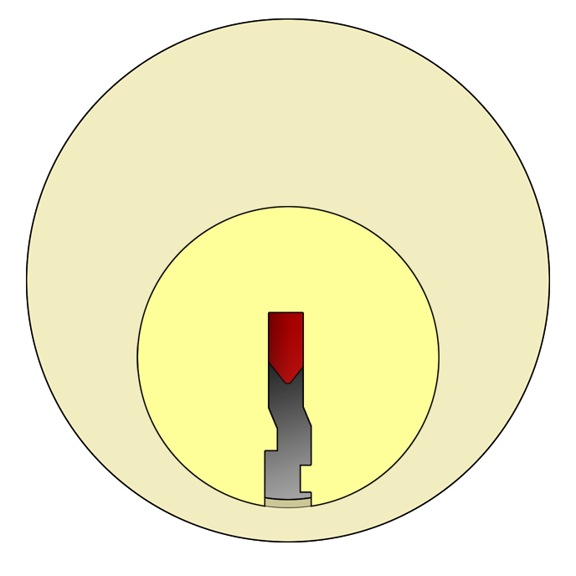
Outer View
Notes:
This is an illustration of a pin tumbler lock

Slide 8
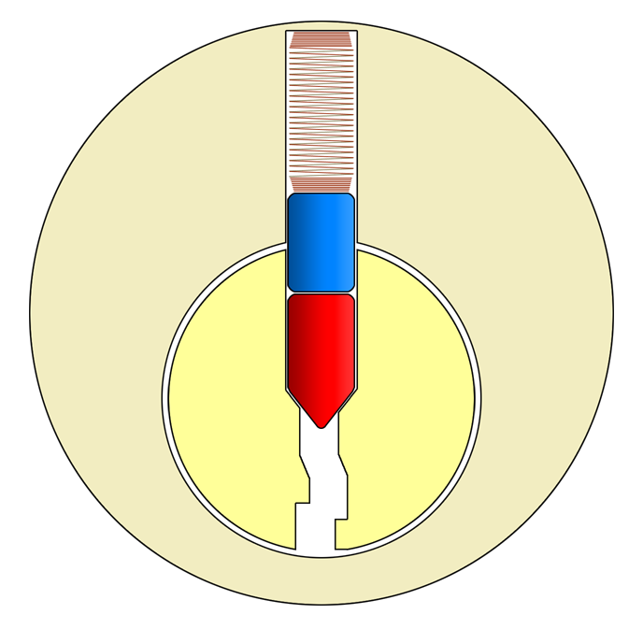
Inner View
Notes:
This is an illustration of a pin tumbler lock showing the internals from the front.

Slide 9
Anatomy of a Lock
Spring
Driver pin
Key pin
Plug
Housing
Notes:
Here are the parts of a pin tumbler lock.
The housing holds everything and doesn’t move.
The plug is the part that turns.
The spring pushes the driver pin which drives the key pin.
The key pin interacts with the key.
* All of this together is a pin stack.

Slide 10
Anatomy of a Lock
Spring
Driver pin
Key pin
Shear line
Plug
Housing
Notes:
The shear line is the area where the pins, housing, and core interact.

Slide 11
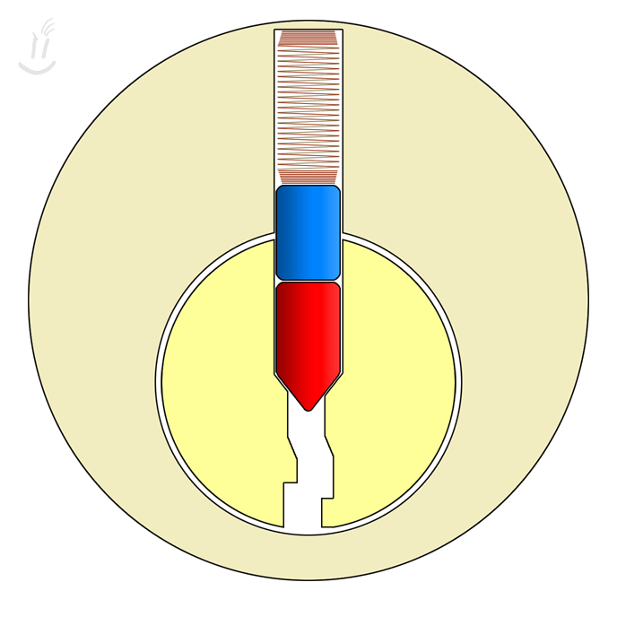
Blocked Shear Line
Shear line
Notes:
When the lock is at rest, the shear line is blocked by the driver pin.

Slide 12
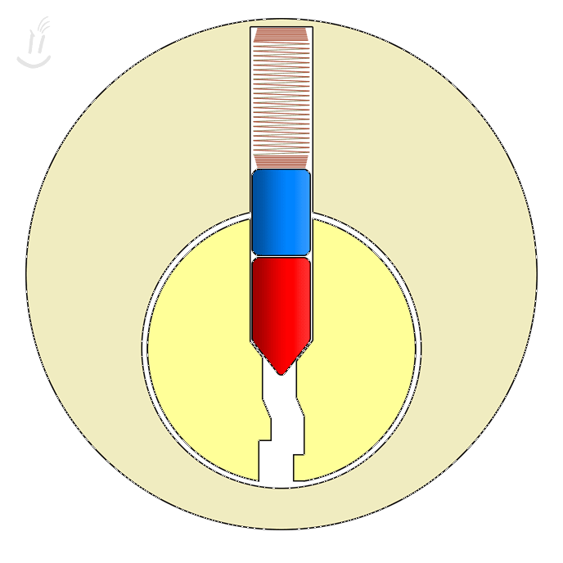
Operating With a Key
Notes:
The key lines up the driver pin and key pin at the shear line.
Since the shear line is no longer blocked, the plug can turn. Key pins go with the key and driver pins stay in the bible.

Slide 13
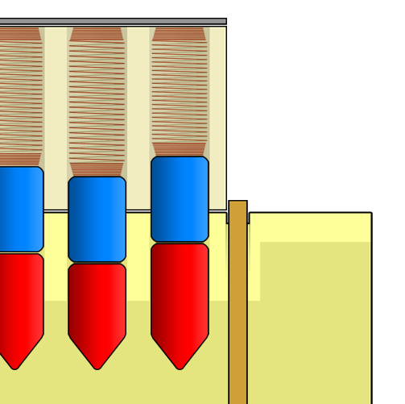
Pin Stacks
Notes:
This is a lock at rest, without a key in it, and with the driver pins stuck halfway between the plug and the housing, blocking the plug from turning.

Slide 14
Pin Stacks
Shear line
Notes:
These pins are blocking the shear line.

Slide 15
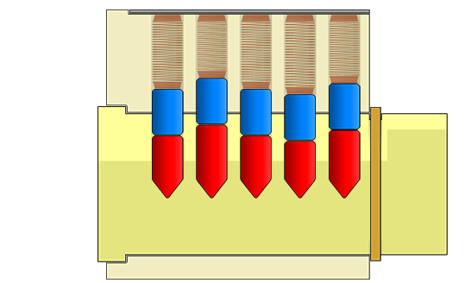
Key Operation
Notes:
The key goes in and pushes up the pin stacks until the key and driver pins are free of the shear line.
As you can see, all of the driver pins are the same size (height), but all of the key pins are different heights.
This is what makes each lock take a different key, because only a key cut to make up for the varying heights of the key pins can even out the differences and create a clear uninterrupted shear line.

Slide 16
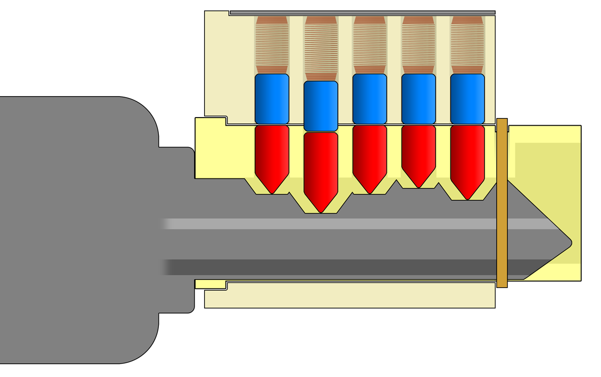
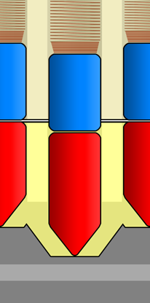
One Bitting Too Low
Notes:
One bitting on the key is cut too low; the driver pin is blocking the shear line and the lock won’t open.

Slide 17
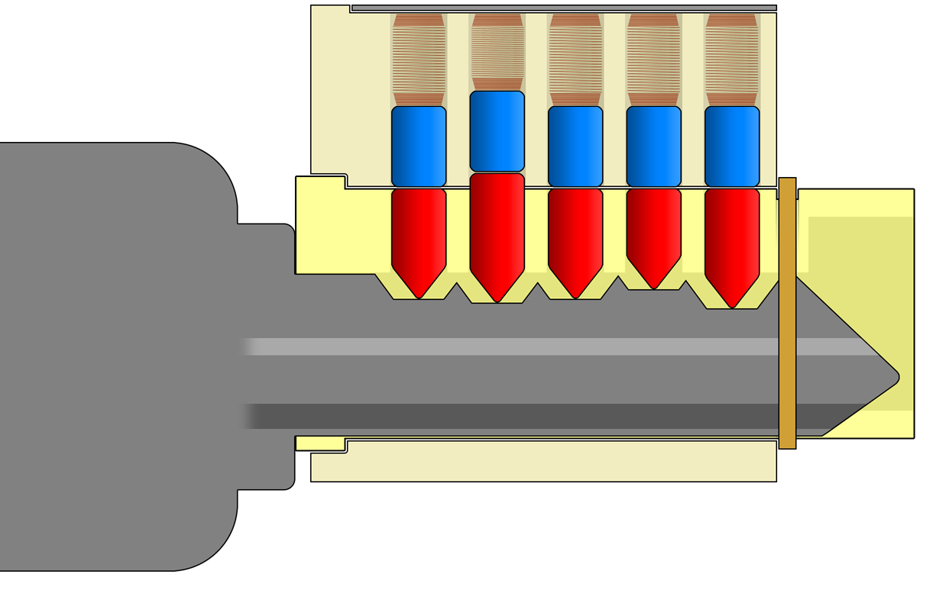
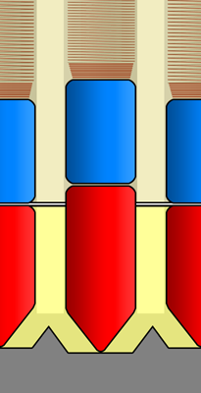
One Bitting Too High
Notes:
One bitting on the key is cut too high; the key pin is blocking the shear line and the lock won’t open.

Slide 18
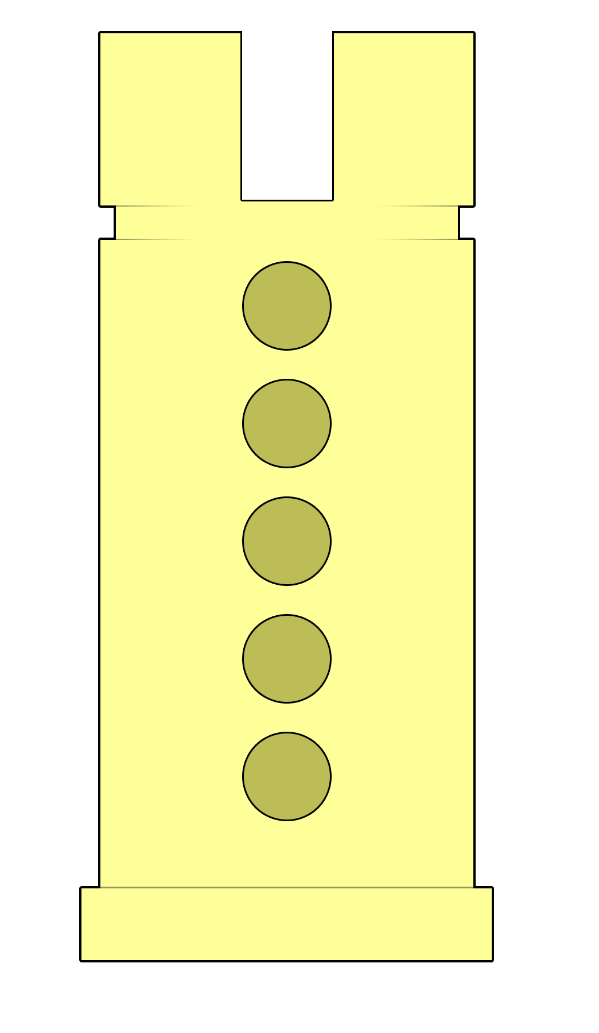
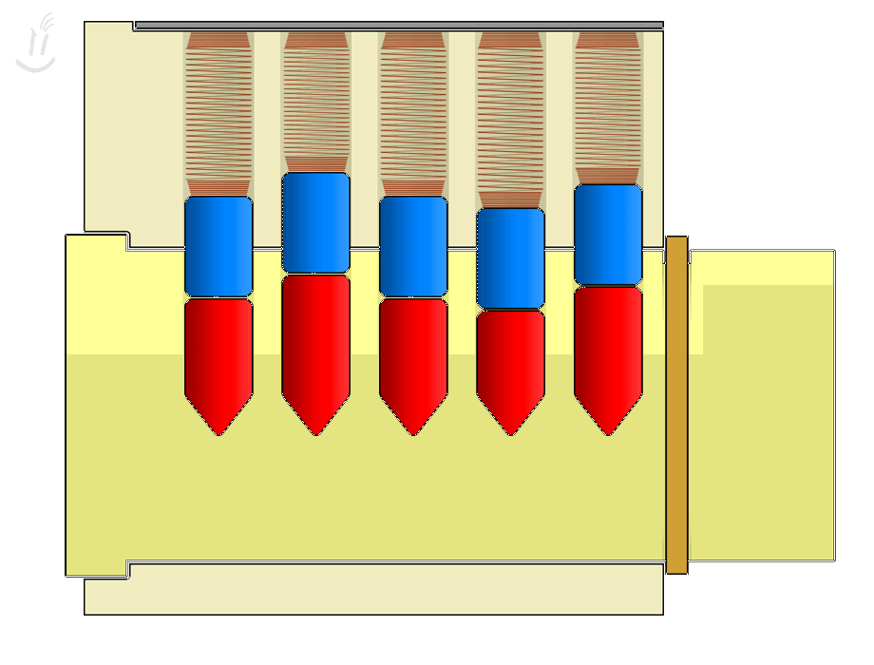
In a Perfect World
Notes:
In a perfect world, all pin tumbler locks would look like this. Holes are perfectly aligned, pins are perfectly cylindrical, surfaces polished
we would not be able to pick this lock.
Very tight tolerances makes a more difficult lock to pick—but it’s still pickable.

Slide 19
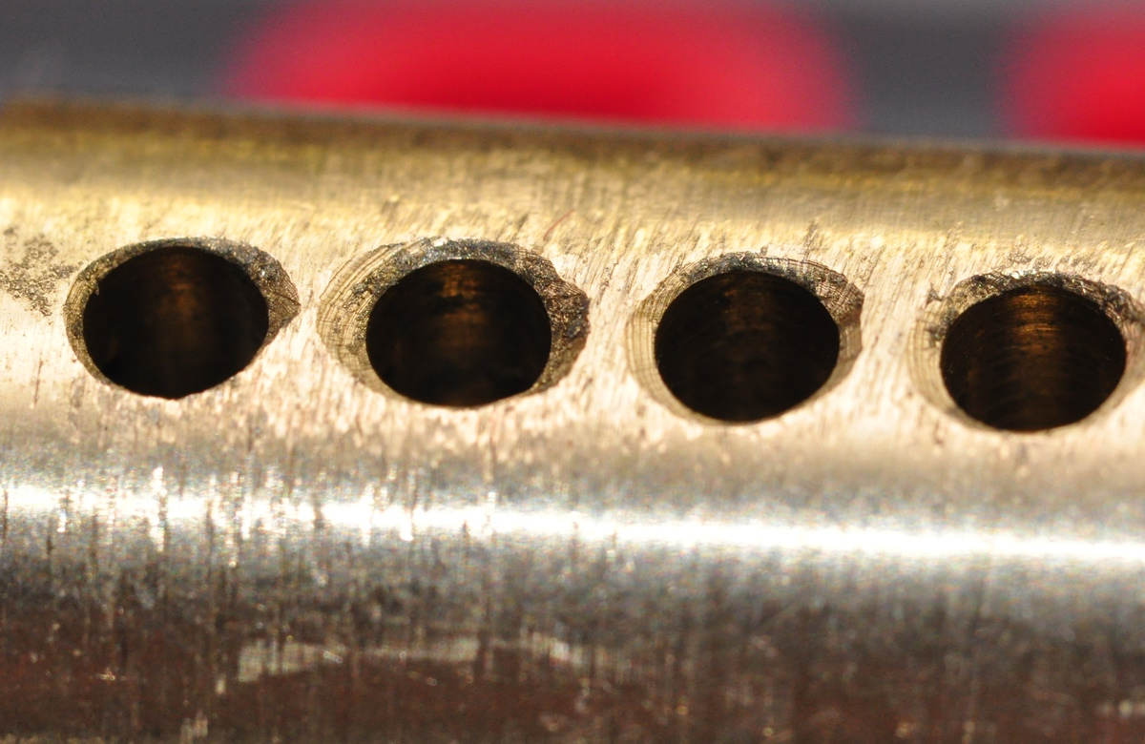
In the Real World
Notes:
In the real world, locks cost money and so they have to be made cost effectively.
In the interest of reducing downtime and increasing usable life of tooling, manufacturers have to allow some error within specifications (called tolerance).
Tooling gets old, machines vibrate, and parts stock can vary—mfrs have to allow some variation in the interest of time and, ultimately, profit.
The lower cost of the lock,
the lower the manufacturer’s cost has to be to make a margin,
the less time and attention each lock gets
= the more room tolerated for mechanical defects.

Slide 20
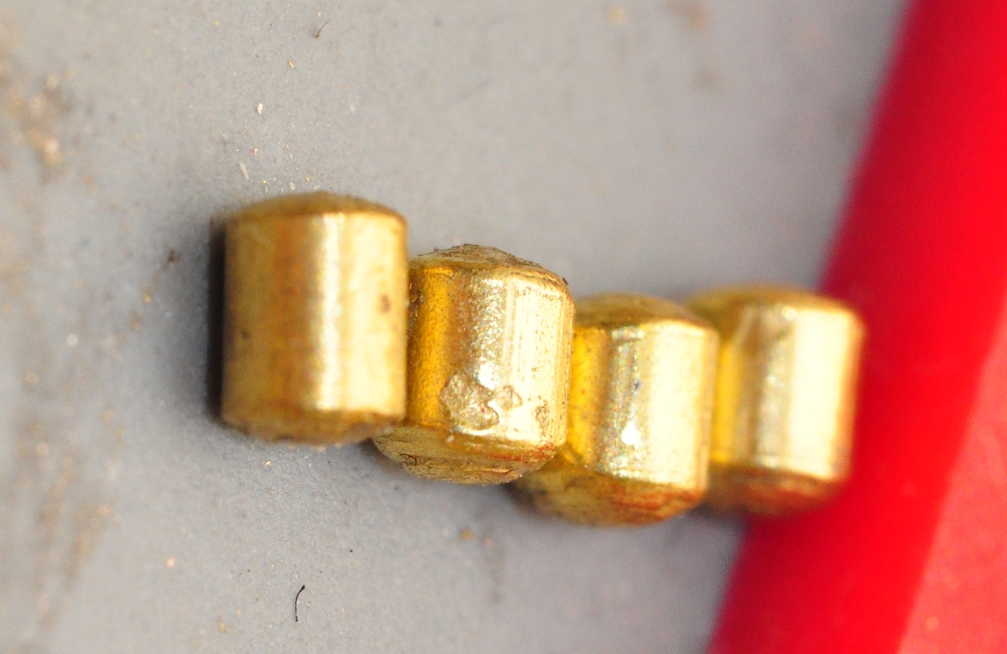
In the Real World
Notes:
Miscast, pitted, rough, rusted, all of the parts of a lock can have small defects that make them work not quite right.

Slide 21
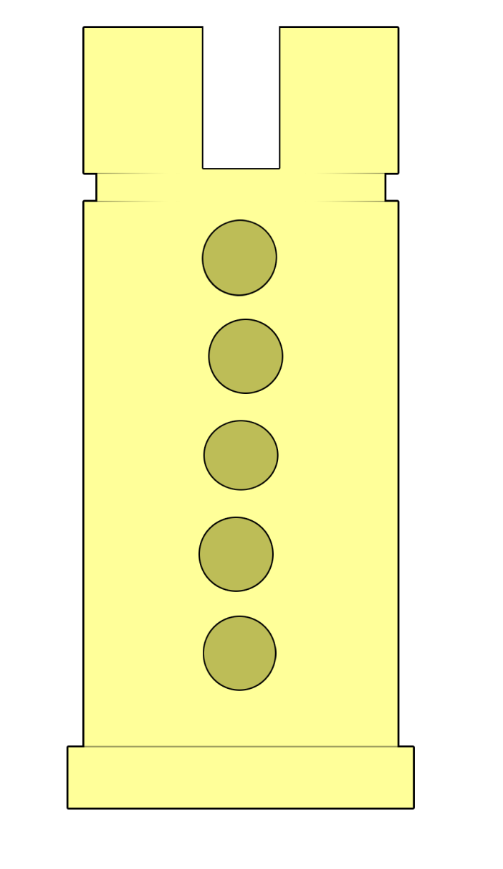

In the Real World
Notes:
Small imperfections in lock production build upon each other.
Misalignment of holes, imperfect pins, etc.
In this case, the second hole from the top is the one most off to the right—if we were to turn the core to the right this pin would pinch—or “bind”—at the shear line first.

Slide 22
Shear Line Interaction
Notes:
Let’s just consider the one pin that is most off center. (In the diagram on the last slight, it’s the 4th pin. [You can have the audience answer this to make sure they’re tracking])
As we’ve seen, if you try to turn a lock plug without a key, it doesn’t open, but something happens.
The plug has a little bit of play before it stops.
What is it stopping against? The first thing it runs into is the most-out-of-line pin.
So it stands to reason that if we move that pin out of the way, the lock will be able to continue turning.

Slide 23
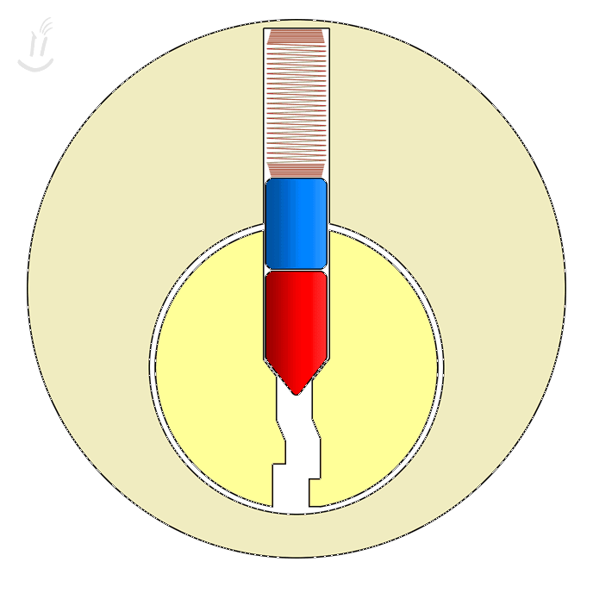
Setting a Binding Pin
Notes:
To move the binding driver pin out of the way, we use a pick to push up on the key pin (red pin).
Once the driver pin is high enough that it’s out of the way, the plug turns slightly.
The driver pin is trapped; it can’t go back the way it came as long as you have light rotational pressure on the core.
This is “setting” a pin, and once you’ve set a pin you can basically forget about it as long as you keep a little bit of turning tension on the plug.

Slide 24
Setting Multiple Pins
Notes:
This is the most important slide and will show you the entire process of picking.
First, we’ll put in a turning tool and apply very light but constant rotational pressure.
Keep pressure on the whole time; if you drop the pressure on your turning tool, you’ll have to start over.
There are two feelings in lock picking: springy or binding.
Use your pick to probe for the convex face of the key pins.
Push each one up and feel for “springy” or “binding”
When you find a springy pin, ignore it.
If you feel a pin that gives resistance, metal-on-metal friction, push it up until it clicks. This is called “setting” a pin. [Point out springy/binding on the animation]
Keep turning pressure on!
When you set the last pin, the lock opens.
(on the small locks on the table, you’ll know you’ve opened it if the core moves at least 90*. On padlocks, the shackle will open.)

Slide 25
Avoid Over-Lifting
Notes:
It is possible to push a pin stack up too high.
The easiest way to avoid this is to make small, controlled, purposeful movements of the pick.
There’s a few mm between pin stacks, and you only need to push pin stacks up by a few mms.
If you’re overlifting frequently, try changing the force of your turning tool and/or pick.
You more likely need to lighten up rather than push/pick harder.
If you have been picking for five minutes or so and you’re not getting any feedback, no clicks, take your tools out of the lock and spin the core back and forth to reset the pins.
[Instructors: please do not teach people to bang locks on the tables!]
So, we’re seeing the picker in this animation set a couple of pins,
and now [third pin to set] we see that they’ve pushed the key pin so high that it is now binding.
It will be difficult to set additional pins, and at this point they should remove their tools and twist the core back and forth to reset.

Slide 26

Two Tools Required
Notes:
There are two tools required in single pin picking.

Slide 27
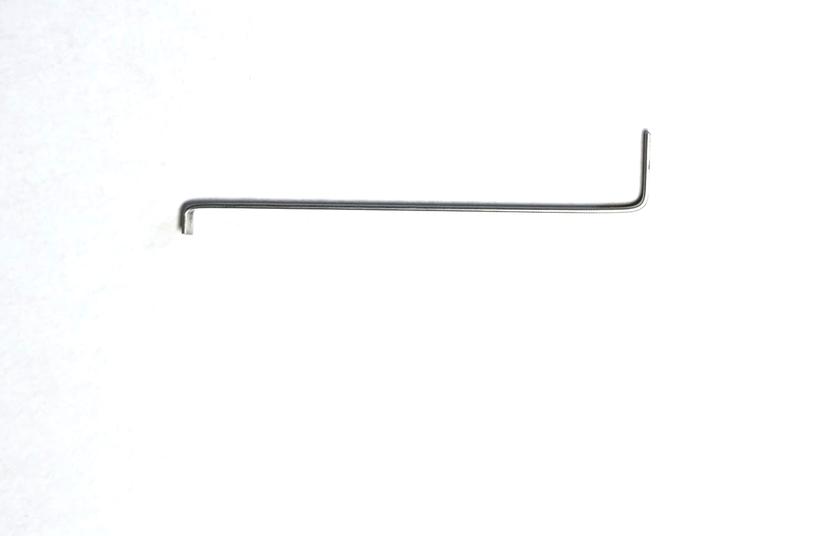
Turning Tool
Top
(Center)
Bottom
(Edge)
Notes:
The turning tool turns (and turns and turns and turns and turns and turns)
Different sizes fit in different keyways; if the tool you’re using doesn’t sit well, try another one.
What does the turning tool do?
TURNS

Slide 28
Bottom/Edge
Turning Tool
Notes:
Bottom:
Most common.
Easy to make
Less expensive to buy than TOK
Very easy to hold because it won’t cam out.

Slide 29
Top/Center
Notes:
Top:
Better feedback and control of turning of the core when the tool fits well.
Slightly harder to hold.
Can be less comfortable to hold things (e.g. KIK cylinders). Try using a lock block.
We can show you TOK and lock block.

Slide 30
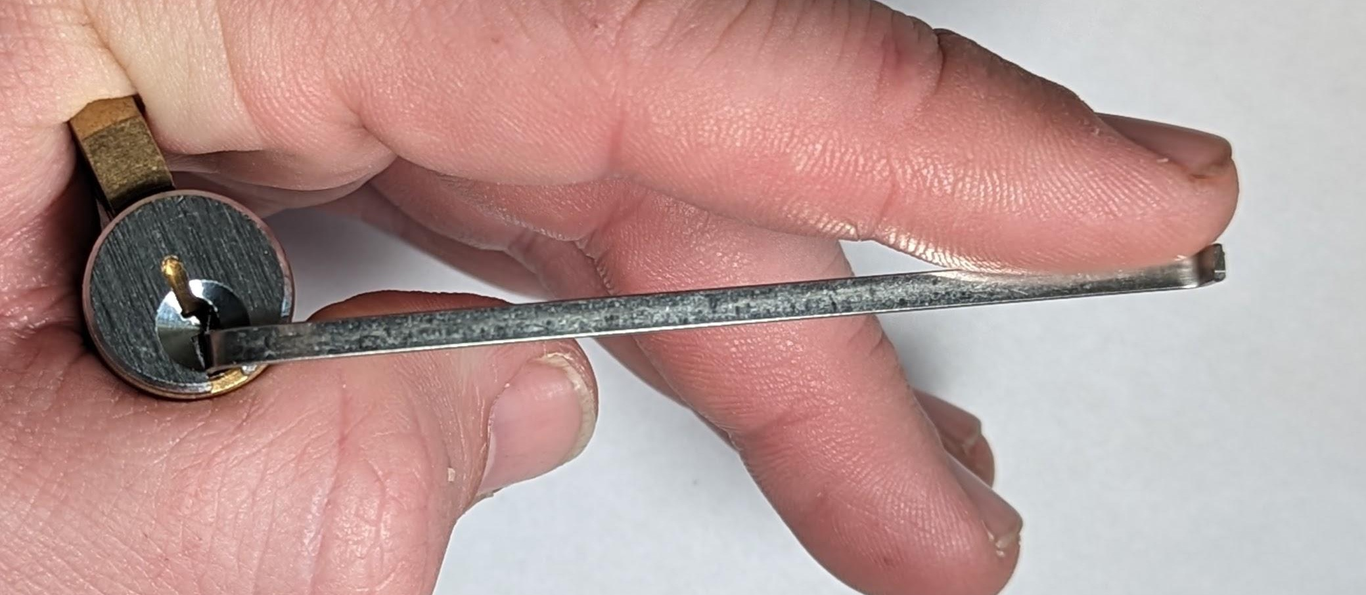
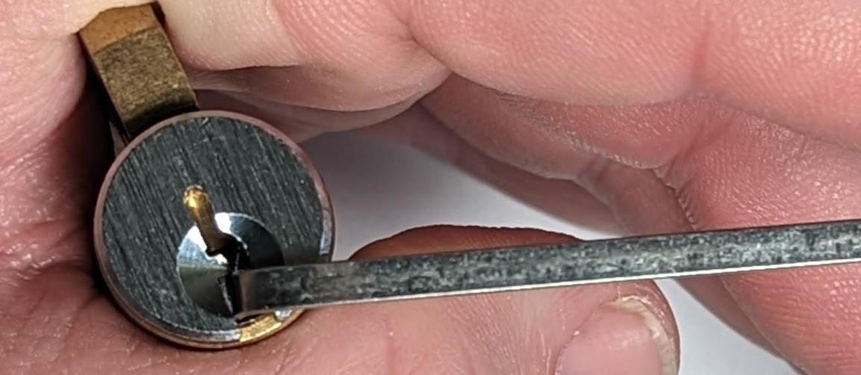
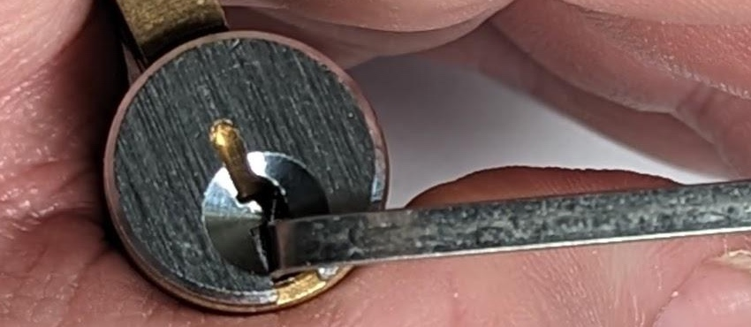
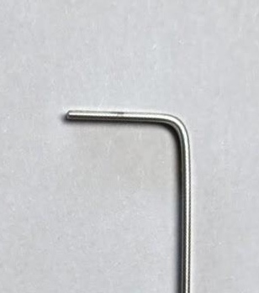
Bottom/Edge
Bottom
(Edge)
Notes:
Two examples showing bottom of the keyway turning pressure.
Start by using bottom of keyway turning pressure. We’ll come around and help you hold things comfortably.

Slide 31
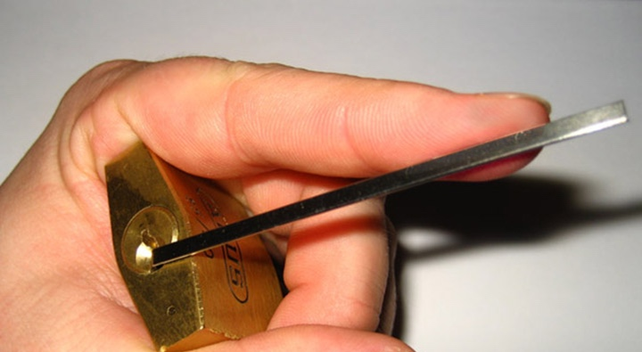
Gently Push at Tip
Notes:
Apply gentle constant rotational pressure with the turning tool. You should be pressing on the thin edge of the tool. This shows how to hold it as a righty.

Slide 32
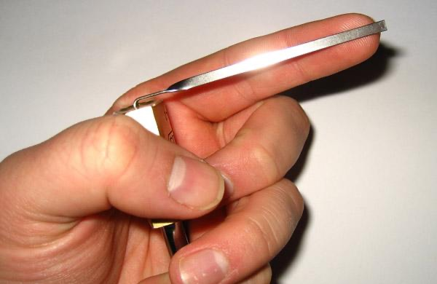
Light Pressure
Notes:
Constant very gentle pressure. If your finger is dented or losing blood, that’s too much.

Slide 33
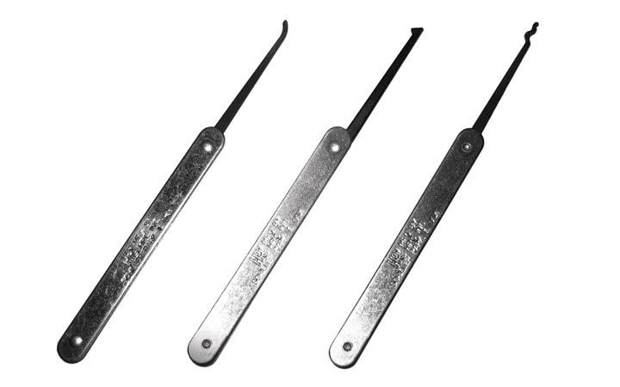
Different Pick Shapes
Notes:
Here’s picks.
Concern yourself with the hook and half diamond. Those are the tools designed for this technique.
Master those tools, and ask a TOOOL member about the other pick shapes and we’ll help you out.

Slide 34
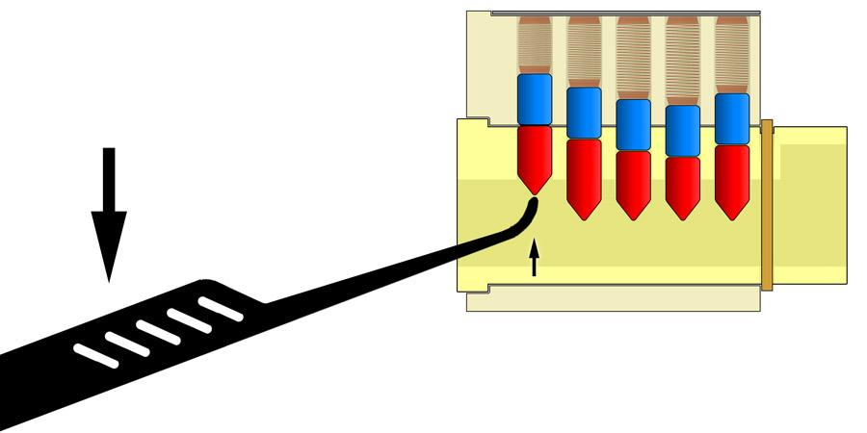
Rocking Lifting
Notes:
Picks go (make stabby forearm) IN, OUT, AND UP AND DOWN.
If you turn the picks, you will have a bad time and the picks will have a bad time.
[while emphatically using stabby motion with forearm]
IN-OUT-UP-DOWN

Slide 35

Be gentle!
Notes:
Lock picking requires thin, delicate tools.
Due to that, picks are consumables.
We expect some of our tools to get bent and forgive you ahead of time.
However, when you bend picks, the bunny cries.

Slide 36
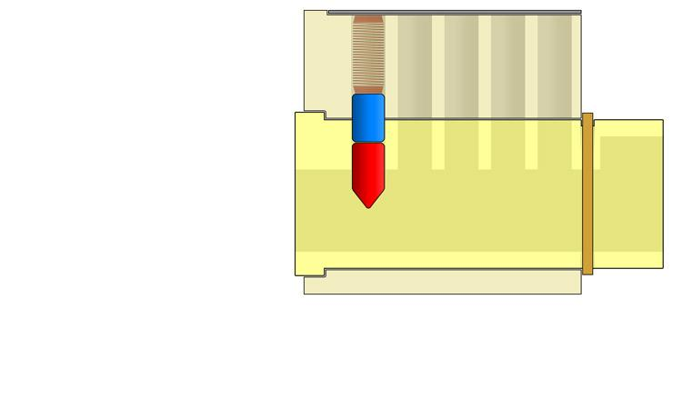
Springy Pin Training
Notes:
Find ”Basic 1”
It has one pin stack right behind the silver face.

Slide 37
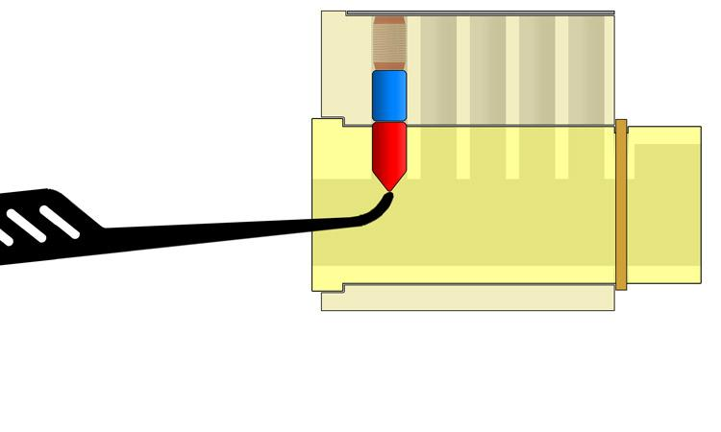
Springy Pin Training
Notes:
In ”Basic 1”, if you put a pick in—
NOT TURNING
—and push up and down on that first pin stack you should feel spring feedback.

Slide 38
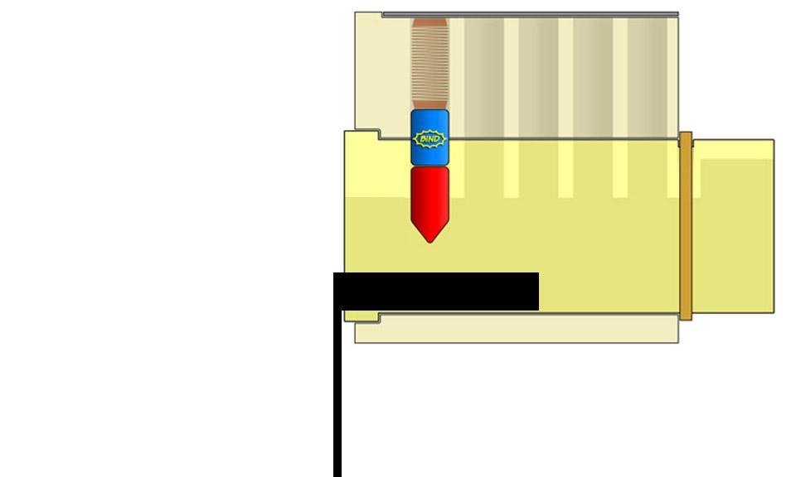
Binding Pin Training
Notes:
Find a turning tool that fits comfortably in the bottom of your Basic 1 keyway.
Use the longer end of the turning tools.
If one turning tool looks smaller than the rest, don’t use that one.
We will help you come around to help you get started holding things.

Slide 39
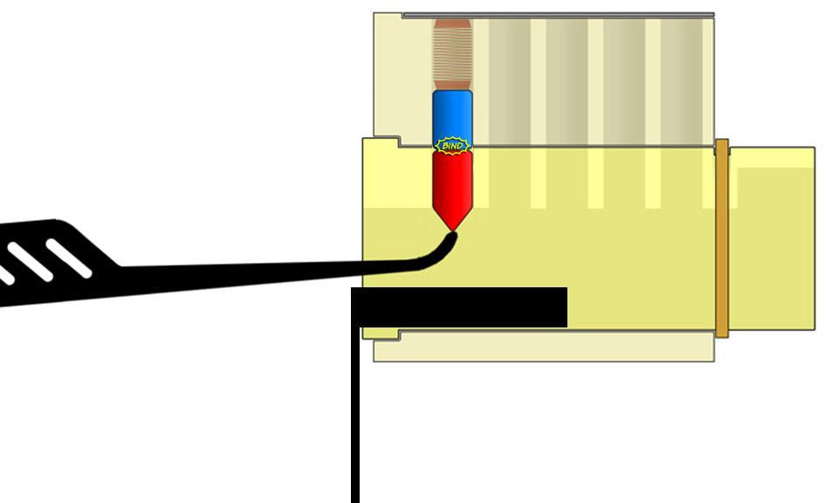
Binding Pin Training
Notes:
When you apply rotational pressure to a Basic 1, which has one pin stack, that pin stack will necessarily bind.
There’s only one pin stack and it’s preventing rotation of the core by intersecting the shear line.
Keep light rotational pressure on your turning tool and push that one pin stack up. You should feel some resistance and then the lock will turn—it’s open.

Slide 40
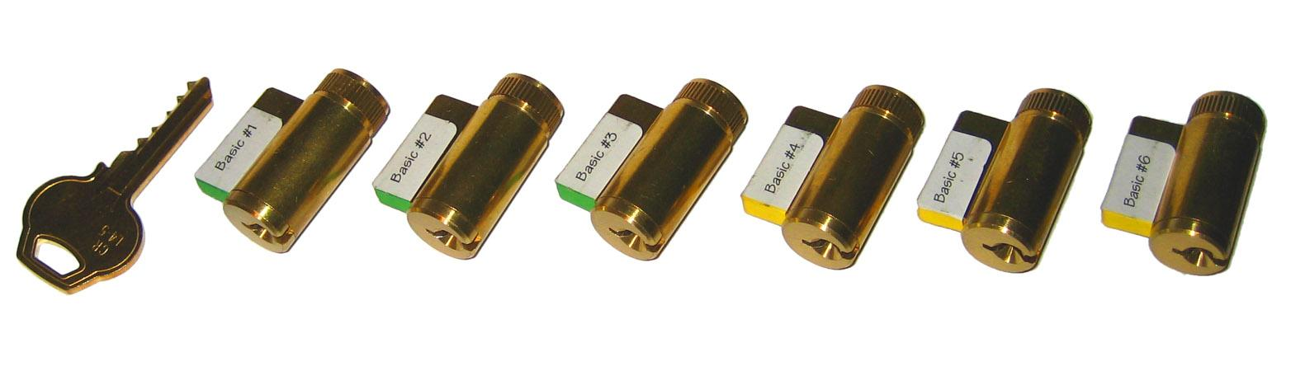

Practice Locks
Notes:
The KIK cores—the ones at the top here—are labeled with the number of pin stacks in the lock.
They are six-pin locks but we have removed some. Then we labeled them with the number of pin stacks that are in the lock.
They are pinned from the front—the silver face—so, in the basic 1 there’s one right behind the face then 5 empty chambers, in the basic 2 there’s a pin stack behind the face and one behind that and four empty chambers.
If you go too far, you will feel those empty chambers. Look at the bible (part that looks like a book, holds the mysteries) and you will need to go a corresponding amount of sixths deep (e.g. in a basic 3, go 3 sixths of the way back from the face)
Use “Basic” KIK locks, when you get to 5 or 6 we can show you the spool locks.
Most of our padlocks have 4 pins and turn counter-clockwise.
If you’re getting strange feedback or none, ask one of us—it may be a higher security padlock.

Slide 41
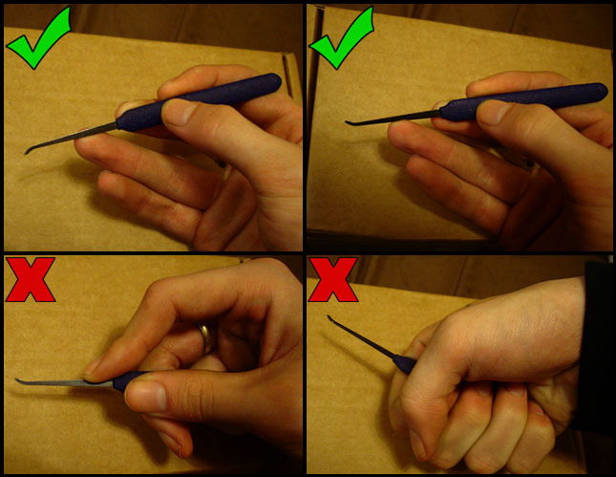
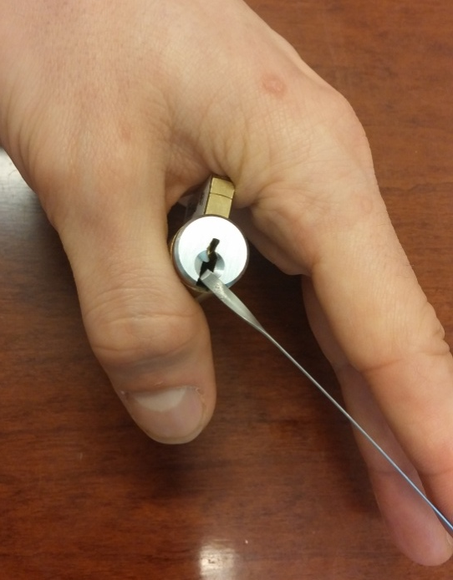
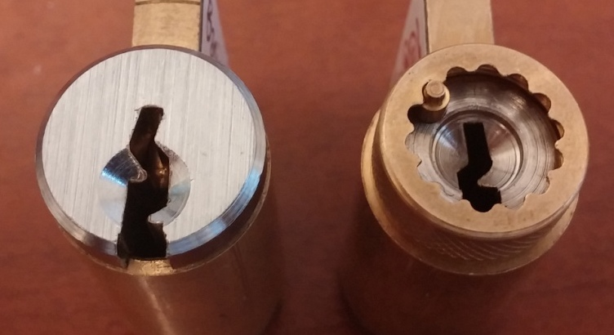
FAQs
Notes:
Here’s a good way to hold lock cores as a right hander.
If you’re left handed, you can mirror this for the KIK locks but will be more comfortable holding padlocks different. Ask one of us how to hold things lefty.
Hold the pick like you would an instrument that you’re using to make very small, purposeful movements with. No stabbystabby.
The silver face is the front of the lock. The octopus mouth is the back of the lock and is usually inaccessible.

Slide 42

The Two Most Important Things…
RELAX
Notes:
Allow this baby [giraffe|Chupacabra|tortoise|leopard|donkey—anything but “cat”] to be your spirit guide through lock picking.
May his comforting venom melt your mind and soul.
More relaxed, more better.
Make a friend, make an enemy, have a drink, distract yourself and your neighbors.

Slide 43

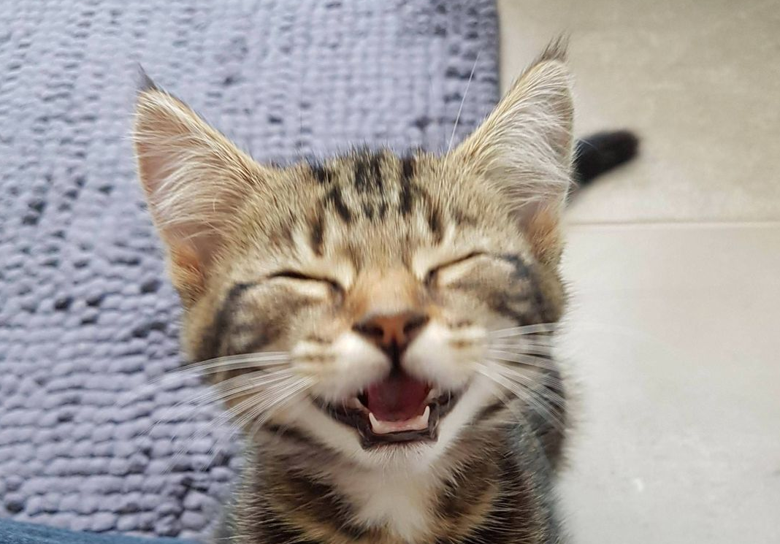
The Two Most Important Things…
Notes:
If you open a lock, feel free to shout Open! [yaaay from TOOOL members] so we can celebrate with you!

Slide 44
Want MORE?
HTTPS://TOOOL.US/ meetings
HTTPS://TOOOL.US/ store
HTTPS://TOOOL.US/ lockfest
Notes:
HTTPS://TOOOL.US/STORE

Slide 45

Our Mission https://toool.us/mission/
The mission of the Open Organisation Of Lockpickers is to advance the general public knowledge about locks and lock picking. By examining locks, safes, and other such hardware and by publicly discussing our findings we hope to strip away the mystery with which so many of these products are imbued.
The more that people know about lock technology, the better they are capable of understanding how and where certain weaknesses are present. This makes them well-equipped to participate in sportpicking endeavors and also helps them simply be better consumers in the marketplace, making decisions based on sound fact and research.
The Open Organisation Of Lockpickers, or TOOOL, is an international group of lock picking enthusiasts originating in the Netherlands with presence in the United States and the UK.
TOOOL in the United States is a 501(c)(3) nonprofit, dedicated to advancing the general public knowledge about locks and lock picking through teaching, research, and competition. We are a volunteer-lead organization with many chapters in the states, including an affiliated Chapter in Canada.
TOOOL’s 990 filings are available through the IRS or by viewing our archive of filings.
https://toool.us/meetings/
https://toool.us/store/
https://toool.us/lockfest/
Notes:
[make everyone from TOOOL raise hands/stand up]
We will be coming around to help you get started, if you have any questions feel free to ask!
TOOOL DC meets the first Wednesday of every month, at the Boardroom
TOOOL BWI meets the second Wednesday of every month, at Unallocated Space
TOOOL NoVA meets the third Wednesday of every month, at NOVALABS
Our website is TOOOL.US
We sell lock picks and other locksport items, ask one of us!
Please do not take tools or locks from the tables. We’re a non-profit, our volunteers work for free, and these locks are meant to serve us for years.
We have locks and picks you can buy! You’re supporting a non-profit!
[Announce game or activity]
[Announce you’re coming around with sign up for monthly reminder email]
Force the audience to to clap for you.

